Slide 1
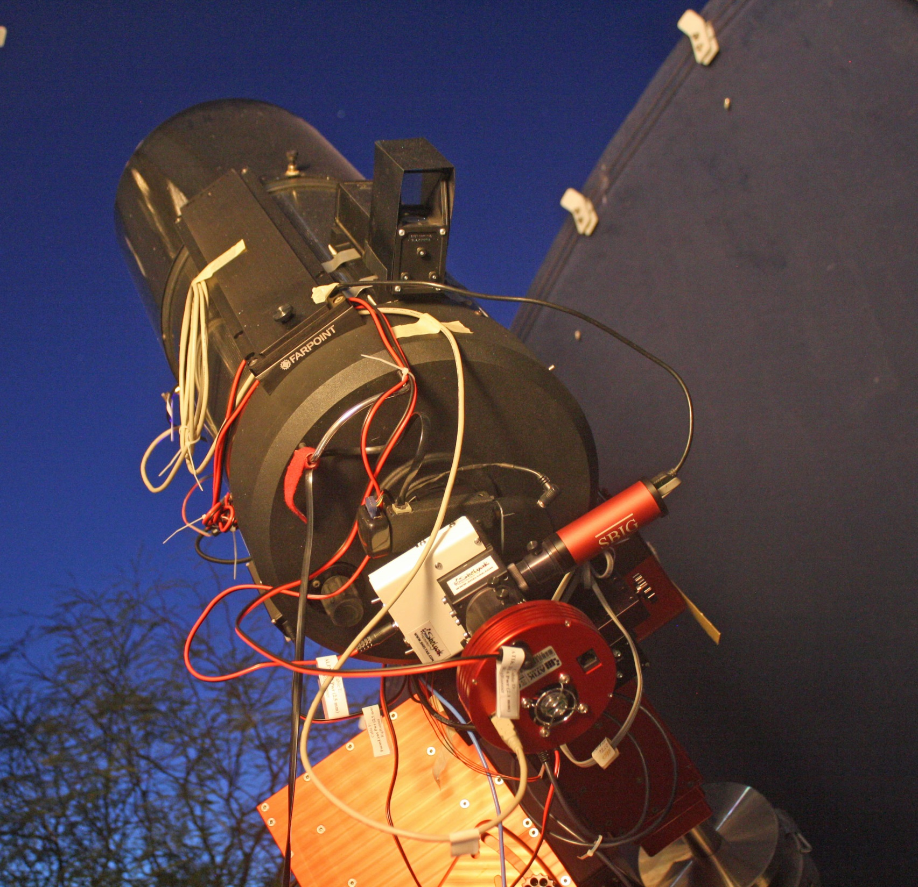
A check of ALPY calibration stability as telescope pointing changes:
German-equatorial mount
Meridian flip between target #1 and #2
Total time span of session ≈ 4 hours
Temperature wasn’t monitored. Guess drop of ≈ 10 deg F over this time span.

Slide 2
Pointing to targets during night. Questions:
Are Cal amp lines stable as pointing (and temp) change?
Are Ref star Balmer lines stable?
Is Dispersion stable?
N
000000
000000
Alt=0
7,8
Alt=30
3,4
Alt=60
E
1
2
meridian flip
5,6

Slide 3
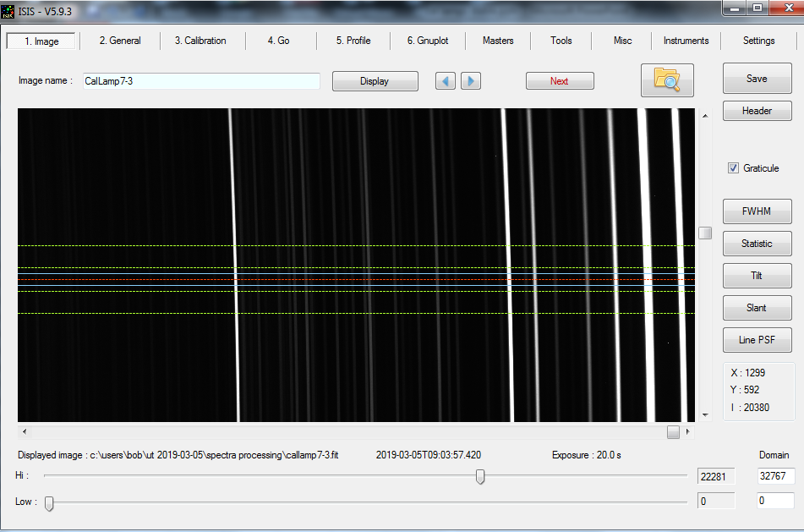
Typical Cal Lamp image, showing red portion.
Measure line positions (X-coordinate) at each telescope pointing direction.
Cal Lamp “red” half
5852.49Å
“red line”

Slide 4
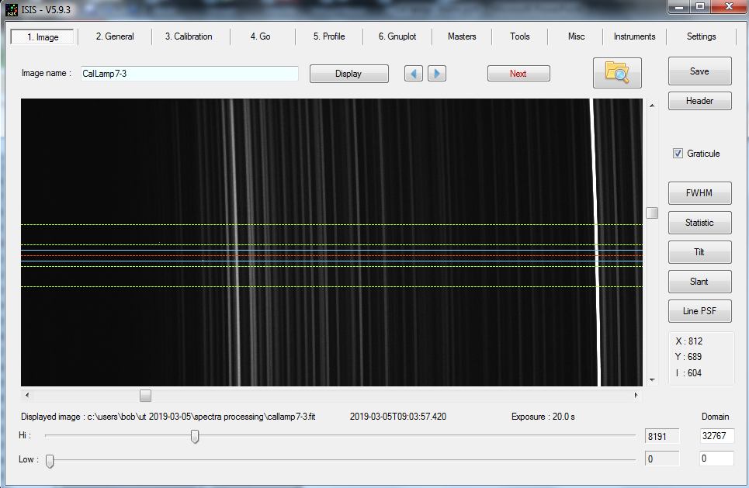
Typical Cal Lamp image, showing blue portion
Cal Lamp “blue” half
“blue line”
5852.49Å

Slide 5
pixel coord (X)
pointing direction
peak-to-peak shift observed ≈ 0.3 pixel ≈ 1 Å
Dispersion in my setup ≈ 3.35 Å/pixel

Slide 6
ISIS ALPY routine uses both Lamp lines and Balmer lines (of Ref Star) to create Calibration polynomial:

Slide 7
Blue-end λ-calibration using Balmer lines of a nearby reference star is better than extrapolating from a (3946Å) lamp line, but it does suffer from uncertainty in measuring line center (weak lines).
Conclusion:
ALPY is remarkably stable (<1Å) ... but do Calibrate at each new target/pointing direction.
Experiment with use of weaker Ne-AR lamp lines at blue end.

Slide 8
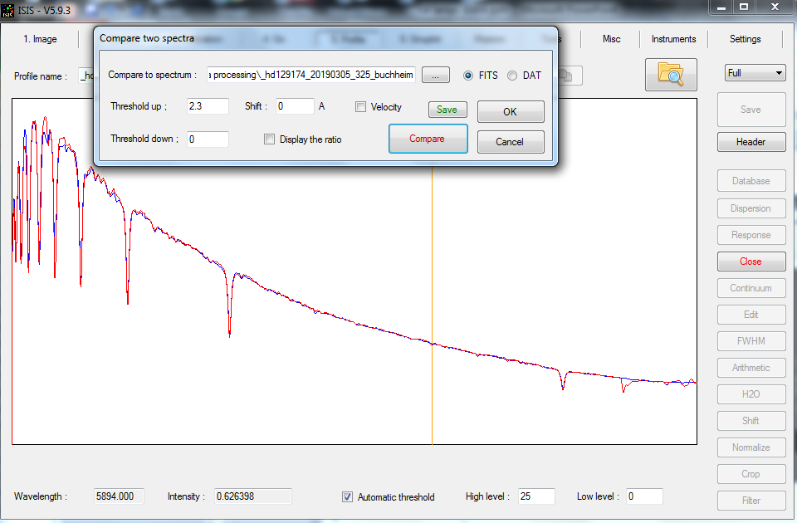
observed calibrated spectrum of HD 129174 (red)
compared to MILES spectrum (blue)
broad view looks good...

Slide 9
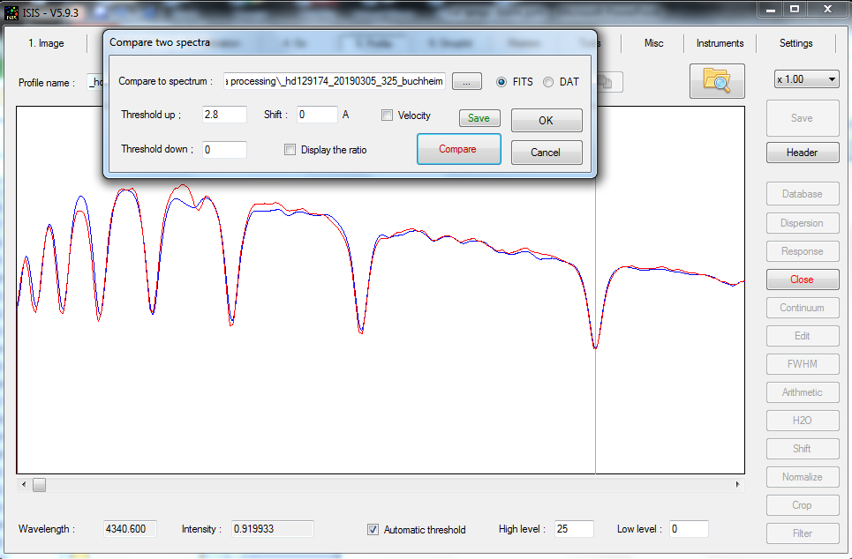
observed calibrated spectrum of HD 129174 (red)
compared to MILES spectrum (blue)
λ calibration at blue end looks good

Slide 10
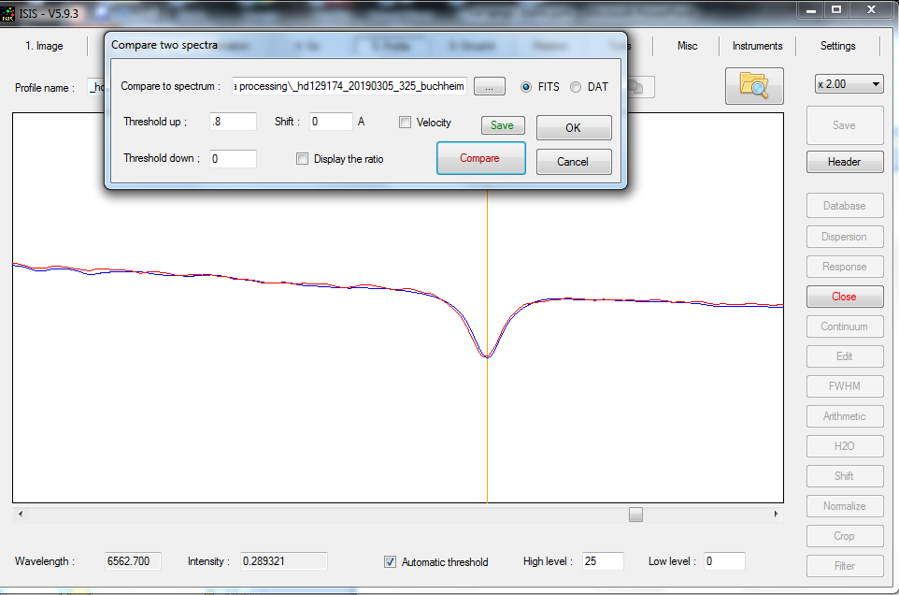
observed calibrated spectrum of HD 129174 (red)
compared to MILES spectrum (blue)
λ calibration at red end (H-α) matches MILES spectrum of this star.

